Slide 1
CCBDA · MIRI · UPC BARCELONA
NRT‑FF
2026 · 11_02
Near‑Real‑Time Financial Forecasting on AWS.
Tesla · Microsoft · Nvidia Two horizons · fully serverless · eu‑west‑1
TEAM 11_02
Ralph Khairallah · Ilias El Mariky · Dalibor Svonavec · Francesco Barillari · Arthur Bohin
FINAL PROJECT · 14 SLIDES · 12 MIN
TEAM 11_02 · NEAR-REAL-TIME FINANCIAL FORECASTING ON AWS · CCBDA-MIRI 2026
01 / 14
Notes:
Good morning. We're team eleven oh two, and we built a near real time financial forecasting system on AWS. It predicts short term moves of three tickers, Tesla, Microsoft and Nvidia, from market prices and live news. I'll open, then each of us walks you through the part we own.

Slide 2
02 · PROBLEM & SCOPE
SPEAKER · DALIBOR
Forecast three tickers, two horizons, fully automated.
TSLA, MSFT, NVDA · equity prices and live news, eu‑west‑1.
REGION
ACCOUNTS
eu‑west‑1
4
Hourly 1 h ahead, refreshed hourly, sentiment-aware.
SEPARATE AWS ACCOUNTS
Daily 7d ahead, refreshed once a day, prices only.
LAMBDAS
AWS SERVICES
Event-driven and fully serverless · no servers to manage, scales to zero.
11
12
In scope: 3 tickers · 2 horizons · 1 dashboard · automation end-to-end.
Cut from first draft: wider ticker universe, custom news scraper.
END-TO-END FLOW
›
›
OUTPUTS
INPUTS
PIPELINE
Prices
Serverless AWS
Forecasts
News
11 Lambdas · Glue · DeepAR
+ Alerts
→ QuickSight dashboard (hourly + daily)
TEAM 11_02 · NEAR-REAL-TIME FINANCIAL FORECASTING ON AWS · CCBDA-MIRI 2026
02 / 14
Notes:
The goal is simple to state, hard to do well. We forecast three tickers at two horizons. One hour ahead, updated every hour, with news sentiment folded in. And seven days ahead, refreshed once a day from prices alone. We kept the scope tight on purpose, three tickers, two horizons, one dashboard, full automation, and we cut a wider universe and a custom news scraper from the first draft, because the real challenge here is event driven plumbing on AWS, not chasing tickers. Everything runs on managed services, scales to zero when idle, and is rebuilt from code. Once it's deployed, there are no servers and no humans in the loop.

Slide 3
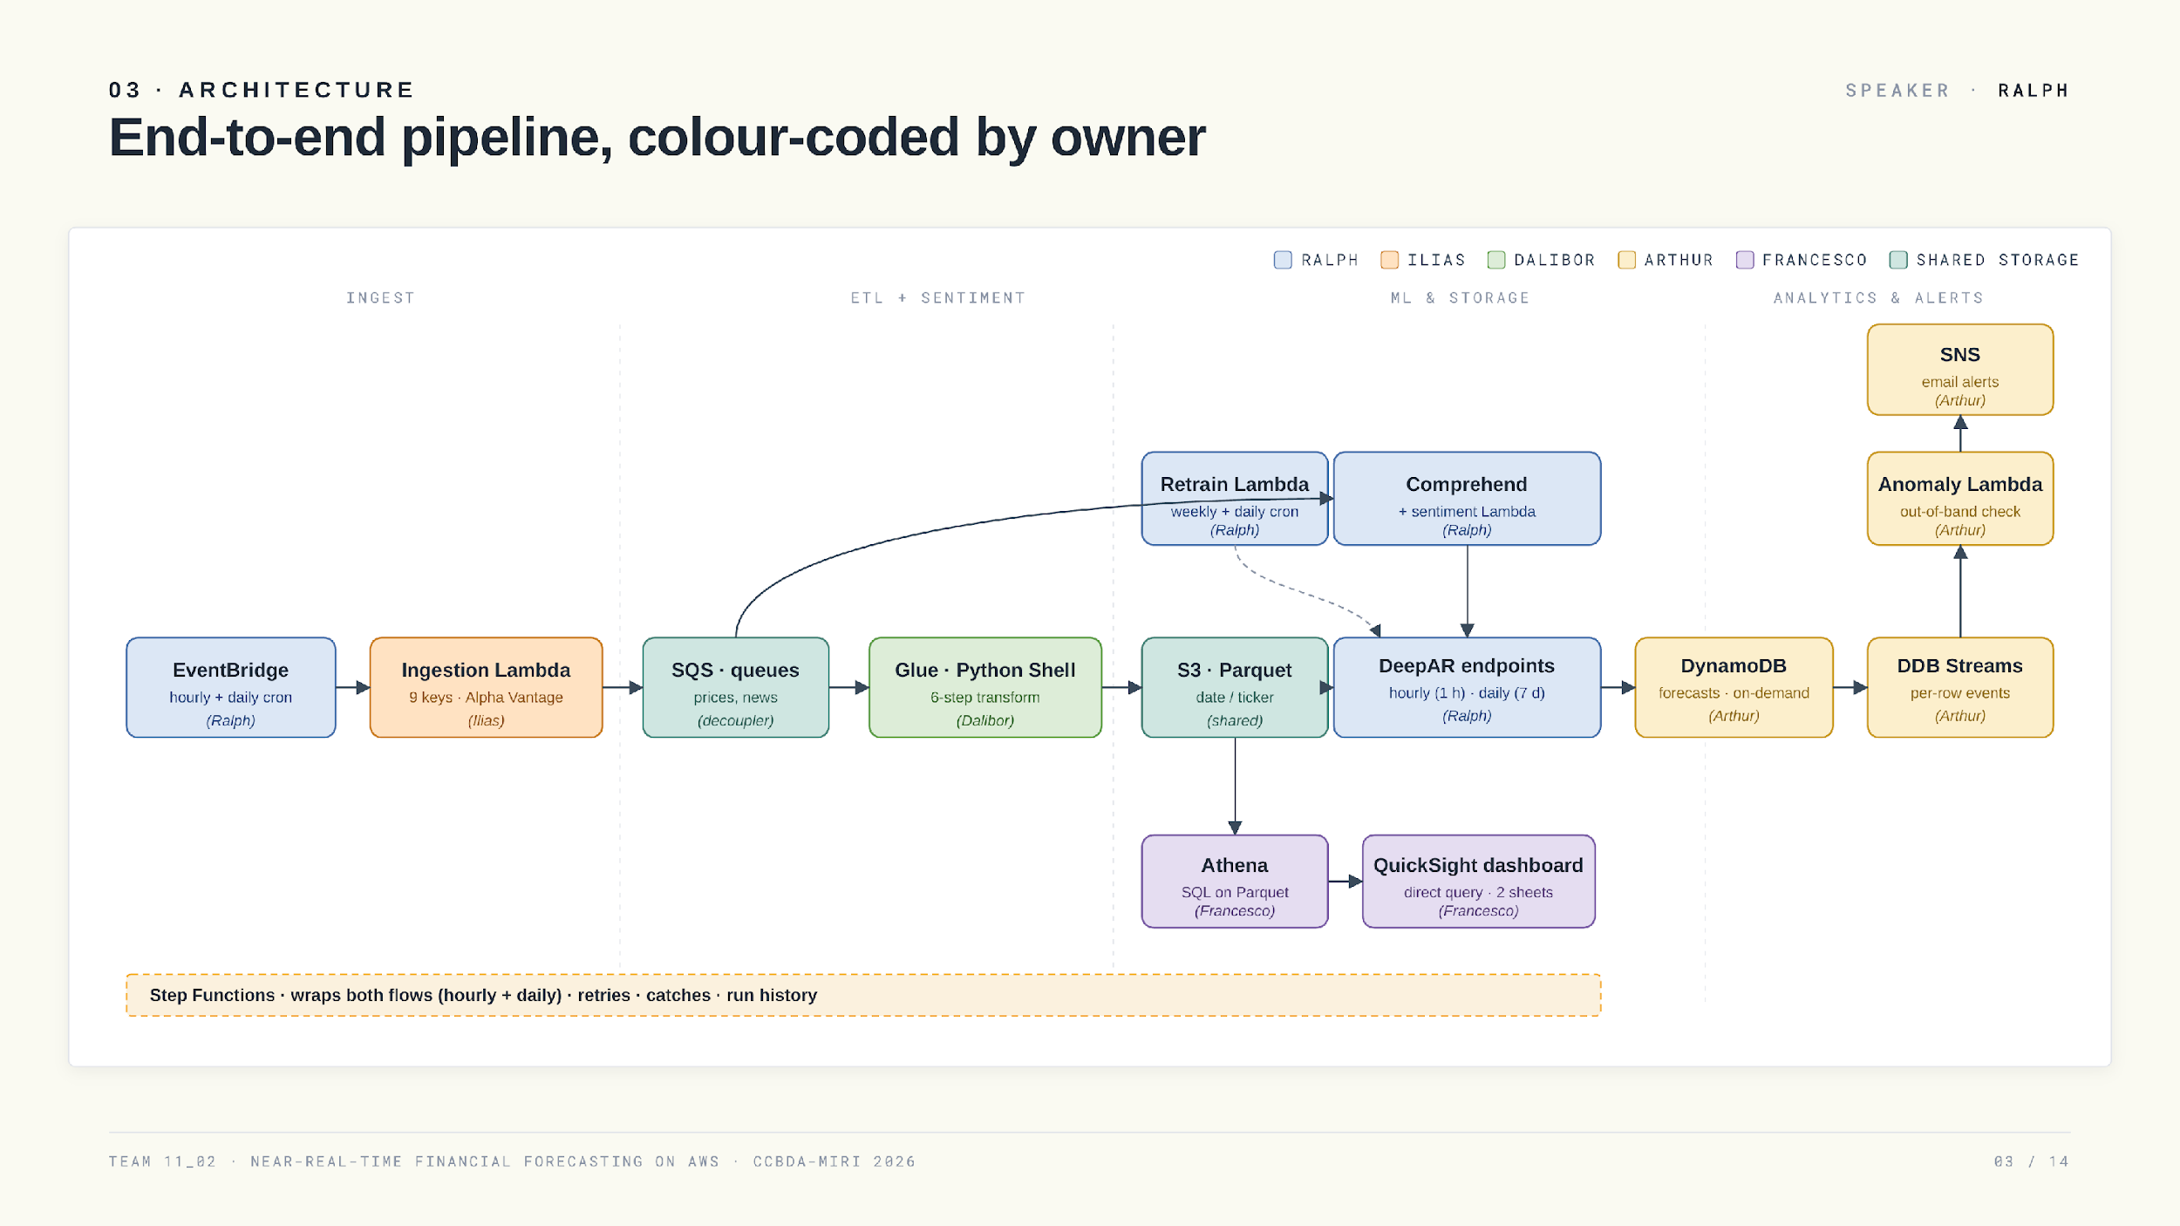
Notes:
This is the full pipeline, color coded by who owns each block. An EventBridge schedule kicks off ingestion. Ilias's Lambda pulls prices and news and publishes them as messages onto two SQS queues. From SQS, two paths run in parallel. On the data path, Dalibor's Glue job drains the price queue, joins in sentiment, and writes partitioned Parquet to S three. On the sentiment path, the news queue triggers a Lambda that scores headlines with Comprehend. Both feed a SageMaker DeepAR serverless endpoint, hourly with sentiment, daily with prices only, and the forecasts land in DynamoDB. A DynamoDB stream triggers Arthur's anomaly Lambda, which emails through SNS when a forecast escapes its band. Athena reads the Parquet and Francesco's QuickSight dashboard queries it. Two Step Functions wrap the hourly and daily flows, and the whole thing spans four AWS accounts. Over to Ilias.

Slide 4
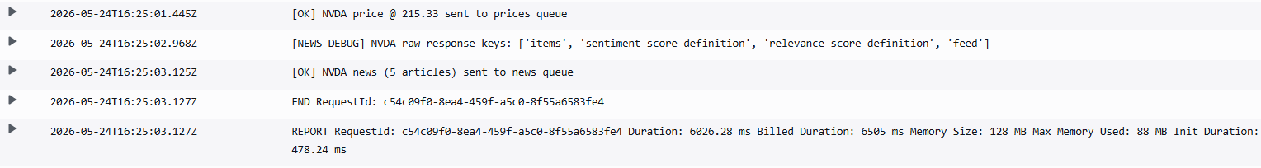
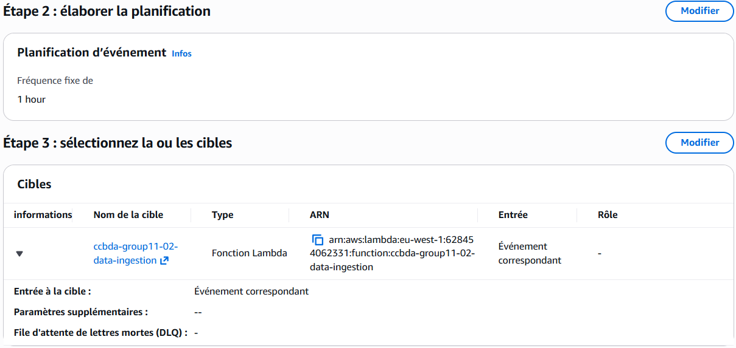
04 · DATA INGESTION
SPEAKER · ILIAS
EventBridge → Lambda → SQS, with 9 rotating API keys.
EventBridge schedule fires hourly for prices and news (offset crons).
One Lambda calls Alpha Vantage (prices + news) and publishes to two SQS queues.
9 API keys rotated in-flight · Alpha Vantage free tier is 25 req/day/key.
Messages go to 2 SQS queues (one for prices, one for news)
CADENCE
API KEYS
TICKERS
Hourly
9
3
TEAM 11_02 · NEAR-REAL-TIME FINANCIAL FORECASTING ON AWS · CCBDA-MIRI 2026
04 / 14
Notes:
My piece is ingestion. The EventBridge rule on the left fires my Lambda on a schedule, hourly for prices and a slower cadence for news. The Lambda calls Alpha Vantage and publishes the results as messages onto two SQS queues, prices and news. SQS is the decoupling layer that feeds everything downstream, nothing talks to my Lambda directly. The interesting bit is rate limits. Alpha Vantage's free tier blocks us fast, so I rotate across nine API keys, three per ticker by the hour, with retries on a four two nine that roll to the next key. That keeps us under the limit at hourly cadence on a five minute data grid, across three tickers, for free. On the right is a real CloudWatch run, finishing well under timeout, with a log line per ticker confirming the send. Dalibor takes it from here.

Slide 5
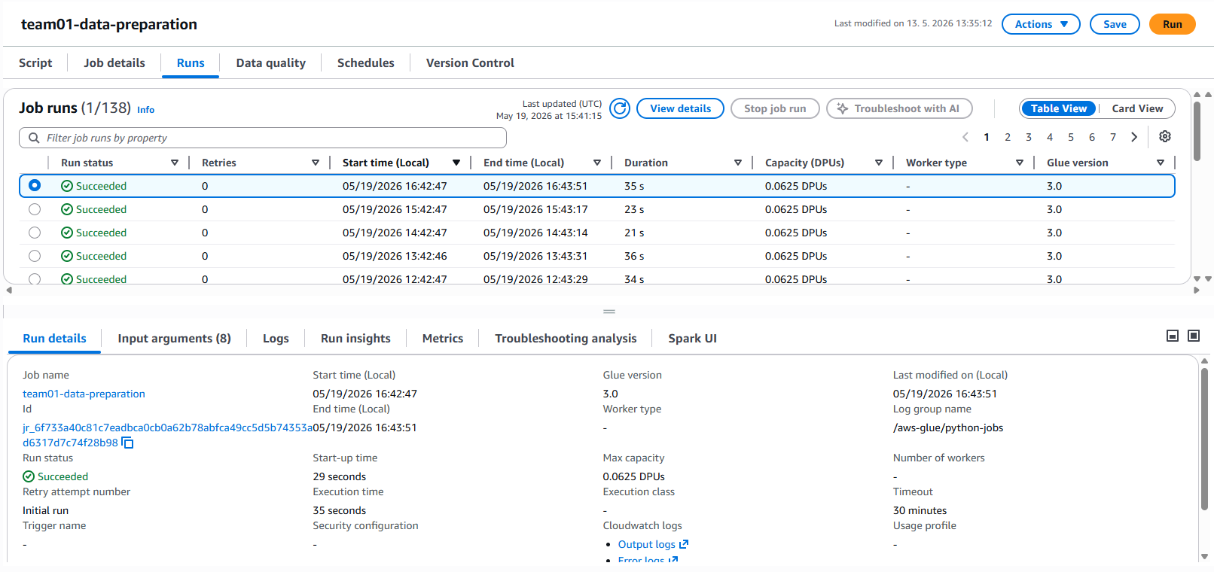
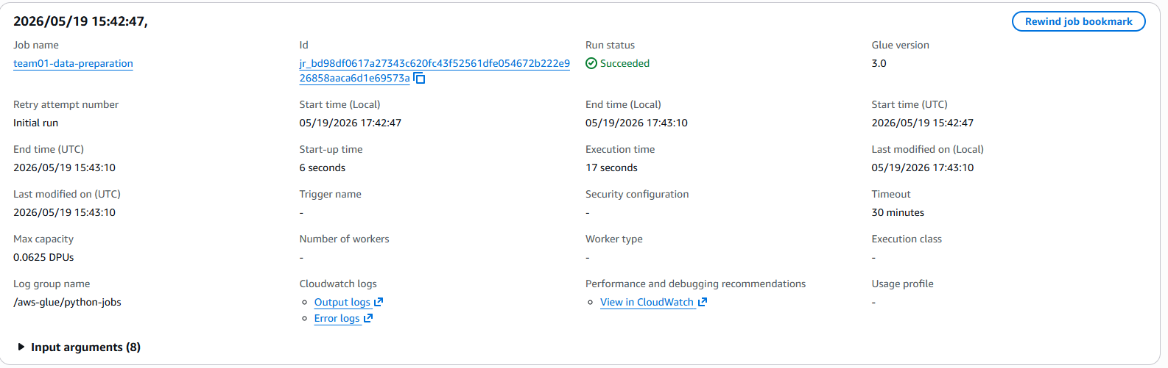
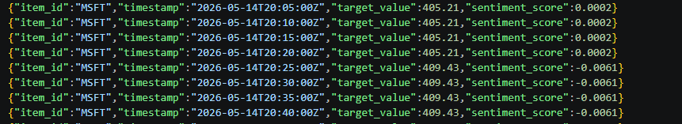
05 · ETL WITH GLUE
SPEAKER · DALIBOR
Glue Python Shell · SQS messages → partitioned Parquet.
SIX-STEP TRANSFORM
01
Drain SQS price messages (JSON)
02
Drop duplicates on (ticker, timestamp) and round timestamps
03
Align to a common 5-min time grid and gap fill
04
Join price + sentiment per ticker
05
Type-cast and sort
06
Write Parquet · partition by ticker
ENGINE
OUTPUT
ON FAILURE
Python Shell
Parquet
CW alarm
COLD-START
TICKER PARTITIONED
TEAM 11_02 · NEAR-REAL-TIME FINANCIAL FORECASTING ON AWS · CCBDA-MIRI 2026
05 / 14
Notes:
My Glue Python Shell job drains the price messages off the SQS queue and reads the sentiment scores Ralph writes to S three. I went with Python Shell over Spark because our volume is small and Spark cold starts would dominate. The job does six things in order. Parse the JSON payloads. Drop duplicates on timestamp and ticker. Align everything to a common five minute grid, because the price and news feeds don't agree on minute boundaries. Join price and sentiment so each row carries both. Cast types. And write Parquet, partitioned by date and ticker. That partitioning is exactly why the dashboard's Athena queries are cheap and fast. On the left is the run history with green successes, on the right one run in detail. A CloudWatch alarm catches any failure, but in practice it's been stable. Back to Ralph for sentiment.

Slide 6
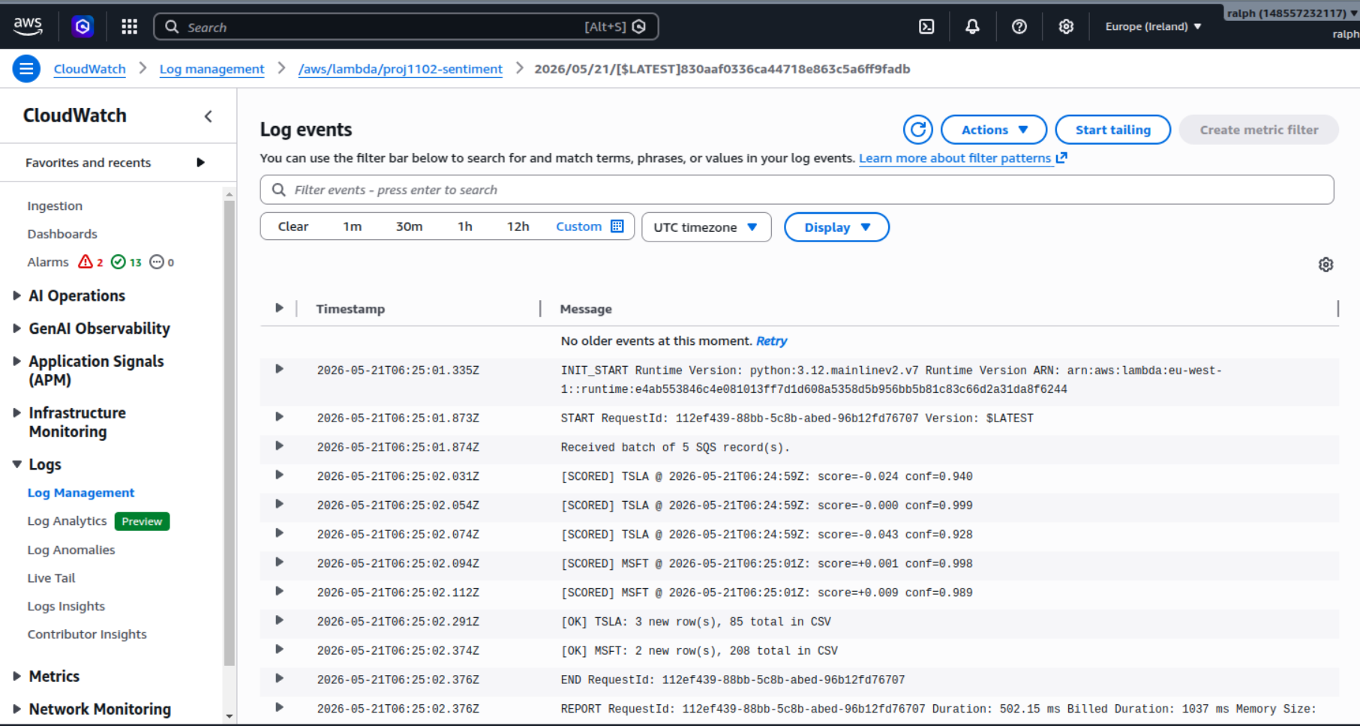
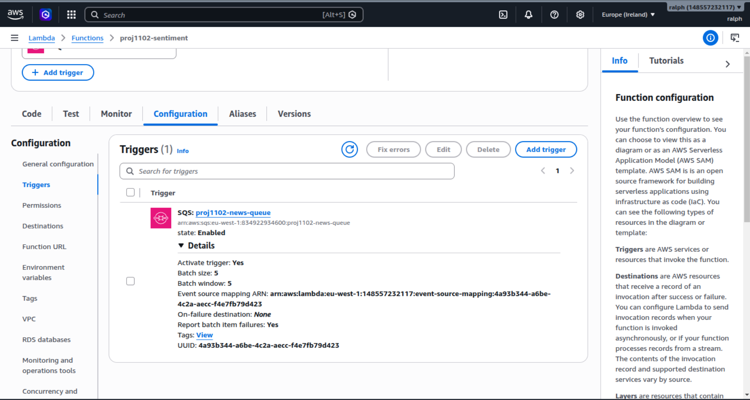
06 · SENTIMENT SCORING
SPEAKER · RALPH
News → Comprehend → a signed score, fed to the hourly model.
SQS on proj1102-news-queue triggers the sentiment Lambda (event-source mapping).
SCORED LOG
Lambda calls Amazon Comprehend per headline.
Probabilities collapsed into a signed score in [−1, +1].
Written back as a related time series next to price.
Used only by the hourly model · daily is prices-only.
Every run logged · CloudWatch monitor on invocation count.
TRIGGER WIRING
score =P_{positive} − P_{negative} · range [−1, +1]
TEAM 11_02 · NEAR-REAL-TIME FINANCIAL FORECASTING ON AWS · CCBDA-MIRI 2026
06 / 14
Notes:
Whenever ingestion puts a news message on the SQS news queue, an event source mapping triggers a small sentiment Lambda. It hands each headline to Amazon Comprehend, which returns four probabilities, positive, negative, neutral and mixed. I take positive minus negative to get a signed score between minus one and plus one, and write it back as a related time series next to the price. So the hourly model sees not just where the price is, but what the news mood looks like. On the right is the live scored log with labels coming through, on the left the trigger wiring. Sentiment feeds the hourly model only, the daily one is prices only.

Slide 7
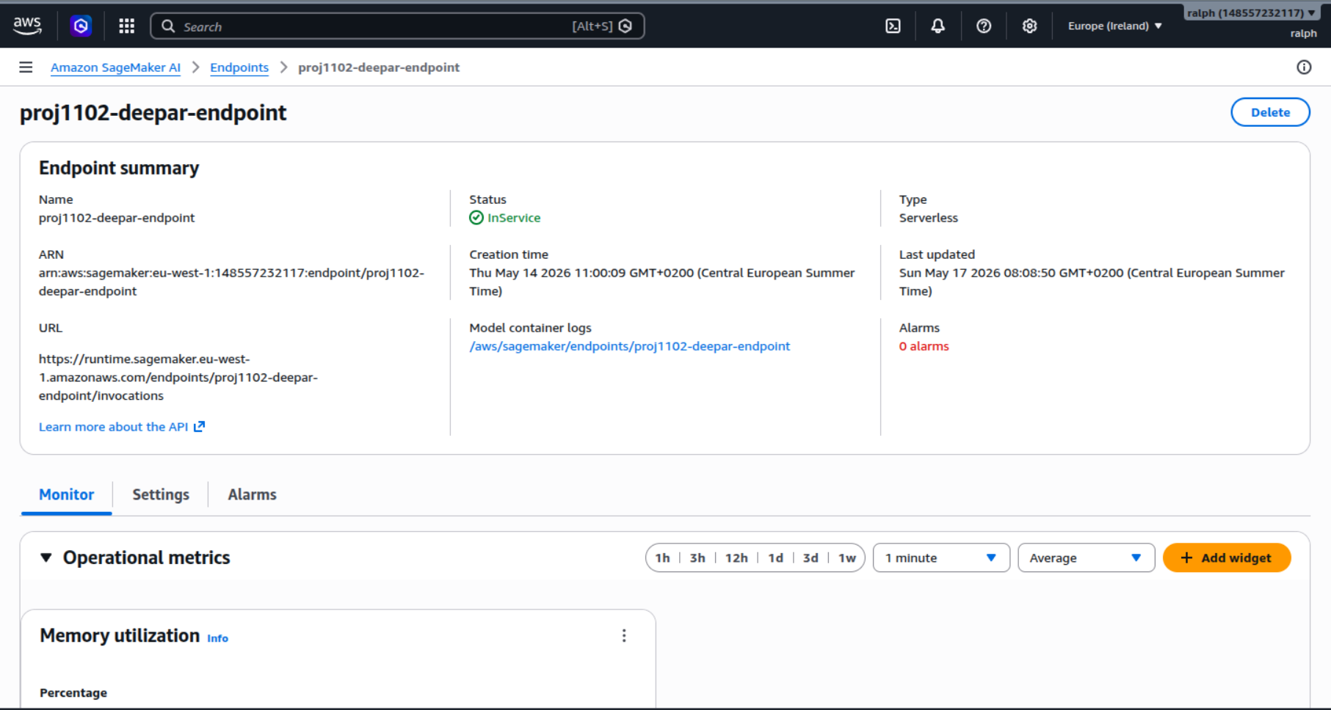
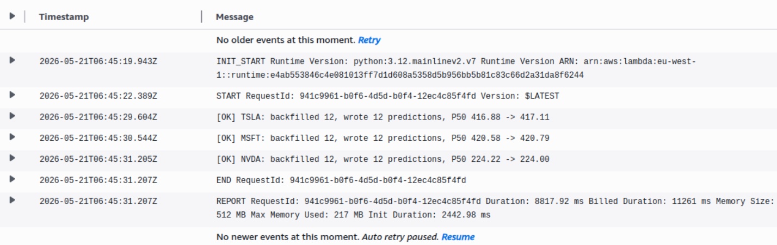
07 · FORECASTING WITH DEEPAR
SPEAKER · RALPH
One global model, probabilistic output, serverless endpoints.
SageMaker DeepAR · deep auto-regressive RNN.
SERVERLESS ENDPOINT · IN SERVICE
One global model learned jointly across all tickers.
Output is a distribution, not a point · P10 / P50 / P90.
Hourly endpoint takes sentiment as a related series.
Serverless endpoints · scale to zero between calls.
Sub-second invocation on warm path · bursty workload.
ENDPOINTS
OUTPUT
IDLE COST
INVOCATION LOG · OK
2
P10/50/90
≈ $0
HOURLY + DAILY
TEAM 11_02 · NEAR-REAL-TIME FINANCIAL FORECASTING ON AWS · CCBDA-MIRI 2026
07 / 14
Notes:
Forecasting runs on SageMaker DeepAR, on serverless endpoints. DeepAR is a deep auto regressive recurrent network that learns one model jointly across all tickers, instead of one per ticker, and that sharing is why it works well with only three series. It outputs a full distribution at each step, not a single number, so we get a P ten, P fifty and P ninety, and the hourly endpoint also takes sentiment as a related series. We chose serverless because invocations are bursty, hourly and daily, so the endpoint scales to zero between calls and costs almost nothing idle. The trade off is a cold start on the first call, which you can see in the log on the left, after that the warm path responds in well under a second. The console on the right shows the endpoint in service. Two horizons next.

Slide 8
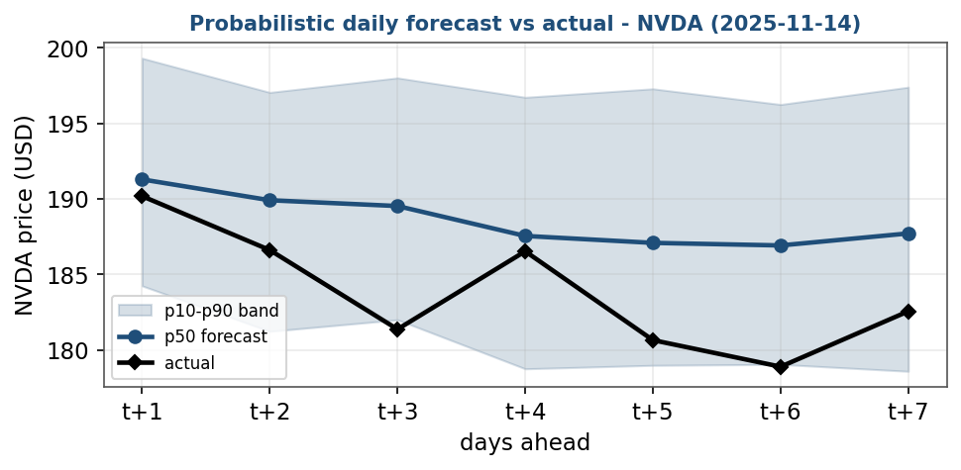
08 · TWO HORIZONS
SPEAKER · RALPH
Same components, two configurations.
HOURLY TRACK
DAILY TRACK
1 hour ahead refreshed every hour
7 days ahead refreshed once a day
CADENCE
every hour
CADENCE
once a day
LOOKAHEAD
1 hour
LOOKAHEAD
7 days
INPUTS
prices + sentiment
INPUTS
prices only
MODEL
DeepAR hourly endpoint
MODEL
DeepAR daily endpoint
RETRAIN
weekly cron (Sun 06:00)
RETRAIN
daily cron
USED FOR
intraday reaction
USED FOR
short-term trend
DAILY 7-DAY FAN · THE BAND WIDENS WITH HORIZON
Same DeepAR algorithm, different horizons. Hourly tracks the market; daily surfaces trend + uncertainty.
TEAM 11_02 · NEAR-REAL-TIME FINANCIAL FORECASTING ON AWS · CCBDA-MIRI 2026
08 / 14
Notes:
We run two parallel pipelines on the same components, configured differently. The hourly track runs every hour, predicts one hour ahead, uses prices plus sentiment, that's the one you watch intraday. The daily track runs once a day, predicts seven days ahead, prices only, that's the trend view. Same Lambda code, same Glue, same DeepAR algorithm, just two endpoints and two Step Functions. Splitting them lets each have its own cadence and its own cost profile. Over to Arthur.

Slide 9
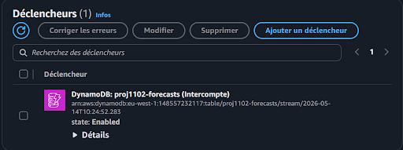
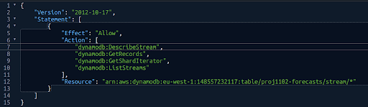
09 · STORAGE & ANOMALY DETECTION (1/2)
SPEAKER · ARTHUR
DynamoDB → Streams → anomaly Lambda → SNS email.
DynamoDB · on demand · pay-per-write, no capacity to manage.
2.Look at the section is_anomaly for each data.
If true, then extract all the financial data of the entry (p50, p10, p90, ticker, actual).
Send a SNS alert to every group members with all the data inside.
STREAM TRIGGER
Out-of-band → SNS publish → team email.
DYNAMODB STREAM · RESOURCE POLICY
TEAM 11_02 · NEAR-REAL-TIME FINANCIAL FORECASTING ON AWS · CCBDA-MIRI 2026
09 / 14
Notes:
Once a forecast exists it has to be stored cheaply and watched continuously. We use DynamoDB on demand, so we only pay per write. Each row carries the ticker, the horizon, P ten, P fifty, P ninety, and the timestamp. The key piece is DynamoDB Streams. Every new forecast emits a stream record that triggers my anomaly Lambda. It compares the predicted P fifty against the recent realized band, and if the forecast falls outside the corridor it publishes to SNS, which mails the team. On the left is the real stream trigger in the Lambda console, on the right an actual alert email from one of our runs.

Slide 10
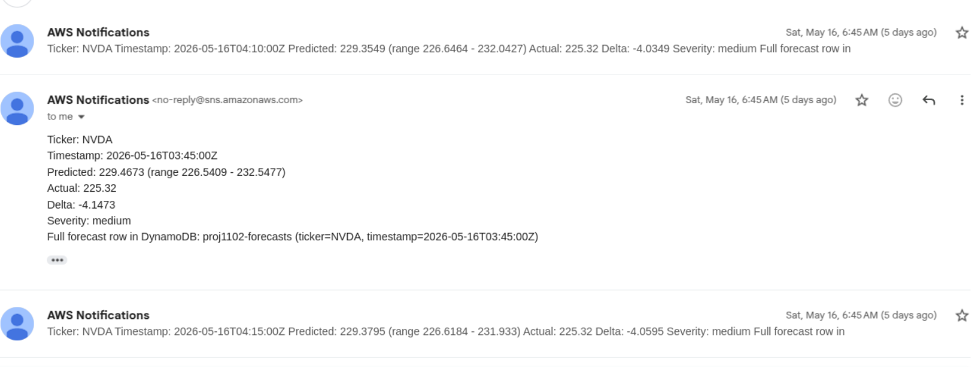
09 · STORAGE & ANOMALY DETECTION (2/2)
SPEAKER · ARTHUR
Alert Example
REAL ALERT EMAIL
TEAM 11_02 · NEAR-REAL-TIME FINANCIAL FORECASTING ON AWS · CCBDA-MIRI 2026
10 / 14
Notes:
Once a forecast exists it has to be stored cheaply and watched continuously. We use DynamoDB on demand, so we only pay per write. Each row carries the ticker, the horizon, P ten, P fifty, P ninety, and the timestamp. The key piece is DynamoDB Streams. Every new forecast emits a stream record that triggers my anomaly Lambda. It compares the predicted P fifty against the recent realized band, and if the forecast falls outside the corridor it publishes to SNS, which mails the team. On the left is the real stream trigger in the Lambda console, on the right an actual alert email from one of our runs.

Slide 11
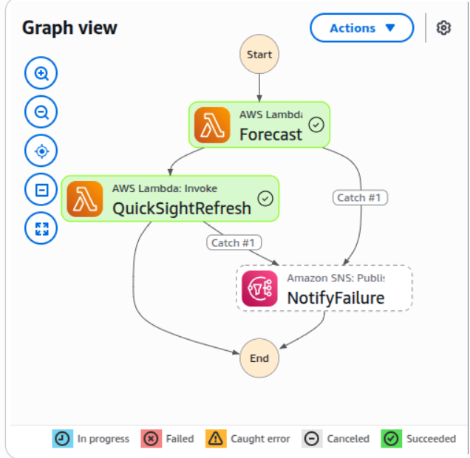
10 · ORCHESTRATION & CROSS-ACCOUNT
SPEAKER · ARTHUR
Step Functions : Orchestration of the pipeline
Organisation : Chain AWS services (Lambda, Glue, Forecast)
Resilience : error handling (Retry and Catch mechanism)
Visibility : Track executions, identify problems (visual interface)
Steps :
Design : Define logical steps of the pipeline
Connect : Link all AWS services
Logic : Manage conditional branching and errors
Deployment : Launch and monitor the process in real time
Graph View :
Really useful to deal with cross accounts !
TEAM 11_02 · NEAR-REAL-TIME FINANCIAL FORECASTING ON AWS · CCBDA-MIRI 2026
11 / 14
Notes:
Orchestration. Each pipeline, hourly and daily, is wrapped in a Step Functions state machine, with retries, error catches, and a clear view of where a run failed. We picked Step Functions over chaining Lambdas because that visibility is worth it. On the right is one of our resource policies, sharing the DynamoDB table and its stream into another account. We split the system across four AWS accounts, and to make them talk we layer three things. S three bucket policies for the data. A DynamoDB resource policy on the table for the writer. And a second policy on the stream itself, because otherwise the cross account consumer can list shards but not read them. That third policy is what cost us the most time, and it's our biggest cross account lesson. Over to Francesco.

Slide 12
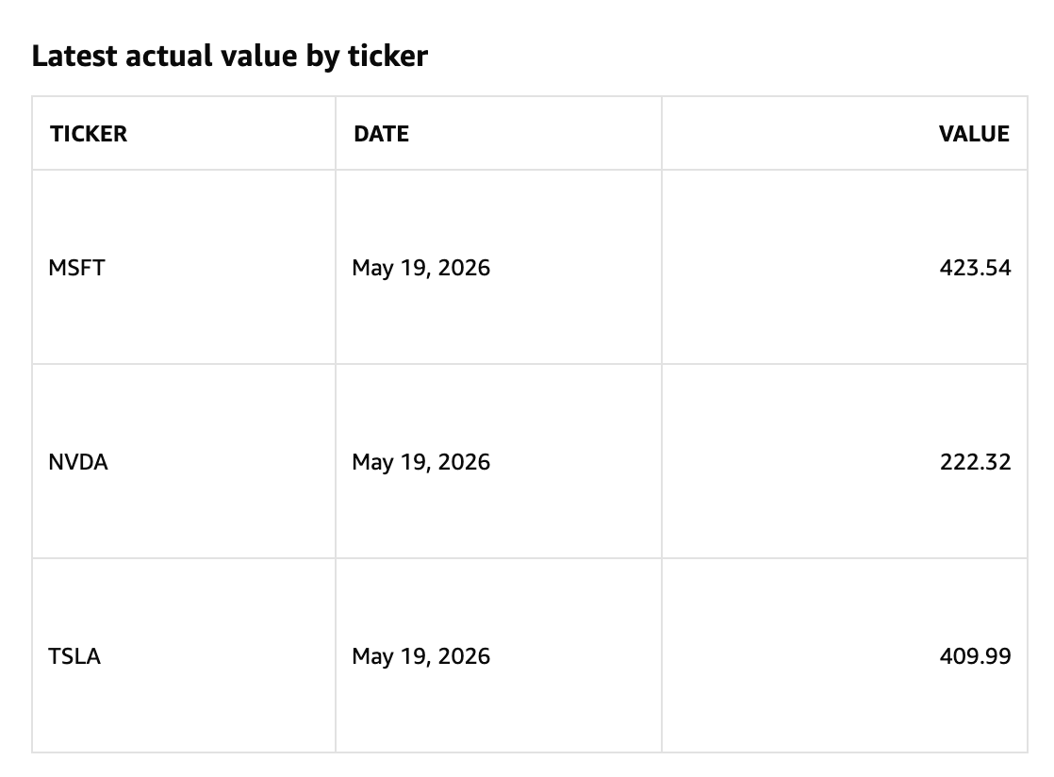
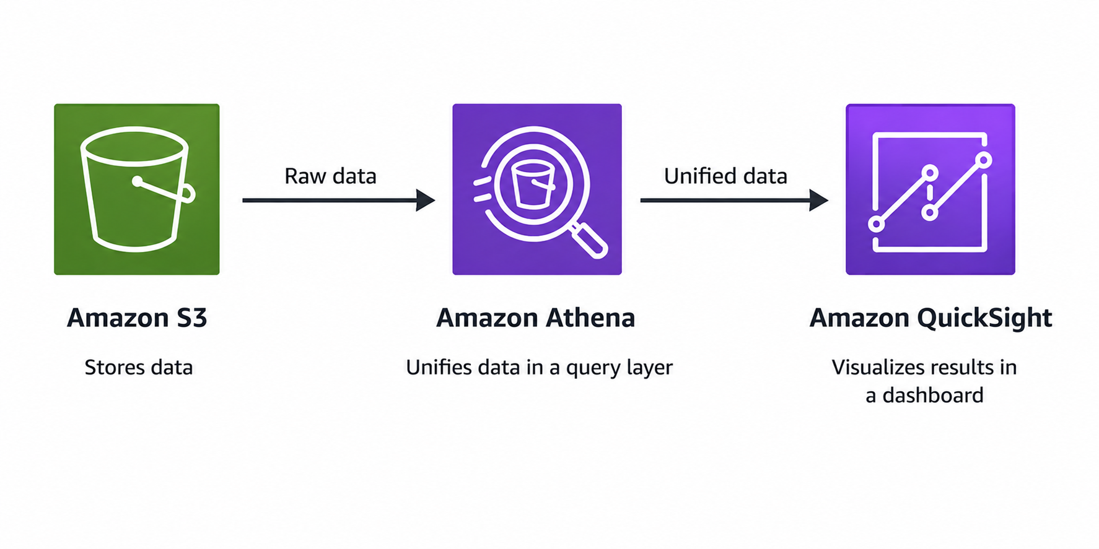
11 · SHOWING RESULTS
SPEAKER · FRANCESCO
Athena → QuickSight : one sheet per horizon
S3: stores actual, sentiment and predictions’ values
Sheet 1 · Hourly · 1-hour-ahead forecasts
Athena: executes SQL queries on unified views
Sheet 2 · Daily · 7-day-ahead forecasts
QuickSight: runs live Athena queries and visualizes interactive forecasting analytics
Interactive dashboard thanks to URL and navigation action
TSLA - NVDA - MSFT analysed in both sheets
TEAM 11_02 · NEAR-REAL-TIME FINANCIAL FORECASTING ON AWS · CCBDA-MIRI 2026
11 / 14
Notes:
The dashboard is where this becomes usable. Curated Parquet sits in S three, Athena queries it with standard SQL, and QuickSight reads Athena in Direct Query mode, so it's always showing current data, no overnight refresh. There are two sheets. The hourly sheet puts the P fifty forecast on top of actual prices, with the P ten to P ninety band shaded, anomaly markers, and a live MAPE tile. The daily sheet is the same idea, seven days out. On the right is the hourly forecast for Tesla, on the left the rolling MAPE that updates as new ground truth lands. Let me show it live.

Slide 13
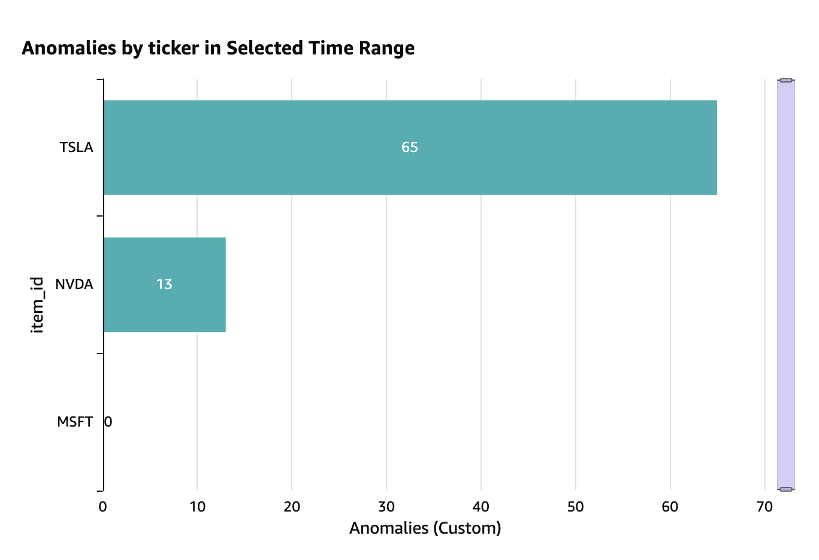
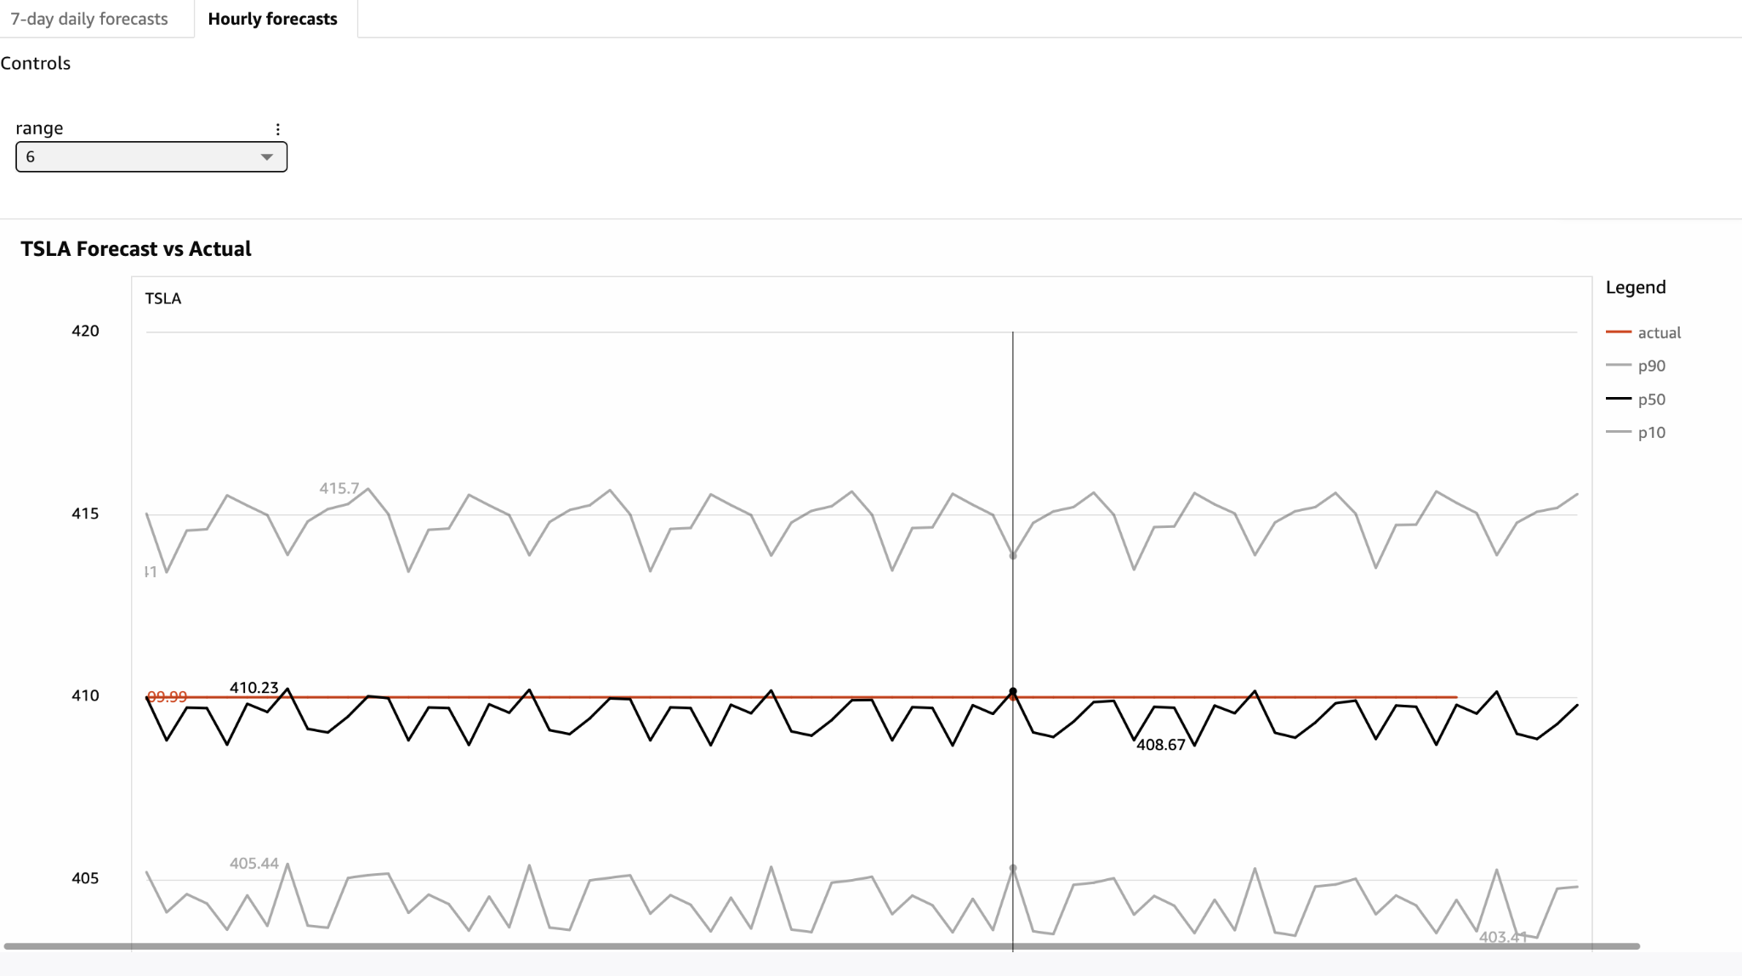
12 · FIRST VISUALIZATION
SPEAKER · FRANCESCO
Hourly Forecasts sheet
Short-range predictions with a forecasting horizon of one hour ahead, updated at 5-minute intervals.
P50 vs actuals, P10–P90 band, anomaly counter, MAPE, spread chart, forecast bias indicator, time range, latest value.
TEAM 11_02 · NEAR-REAL-TIME FINANCIAL FORECASTING ON AWS · CCBDA-MIRI 2026
12 / 14
Notes:
I'll open the dashboard now. I'll start on the hourly sheet, the P fifty line against actuals with the shaded band, switch ticker between Tesla, Microsoft and Nvidia, and point out an anomaly marker. Then the daily sheet, where you can see the fan widen as we look further out. If the live view is slow, these three captures from this morning are my fallback, daily Tesla, the latest hourly anomalies, and a daily spread comparison. Back to Ralph for the numbers.

Slide 14
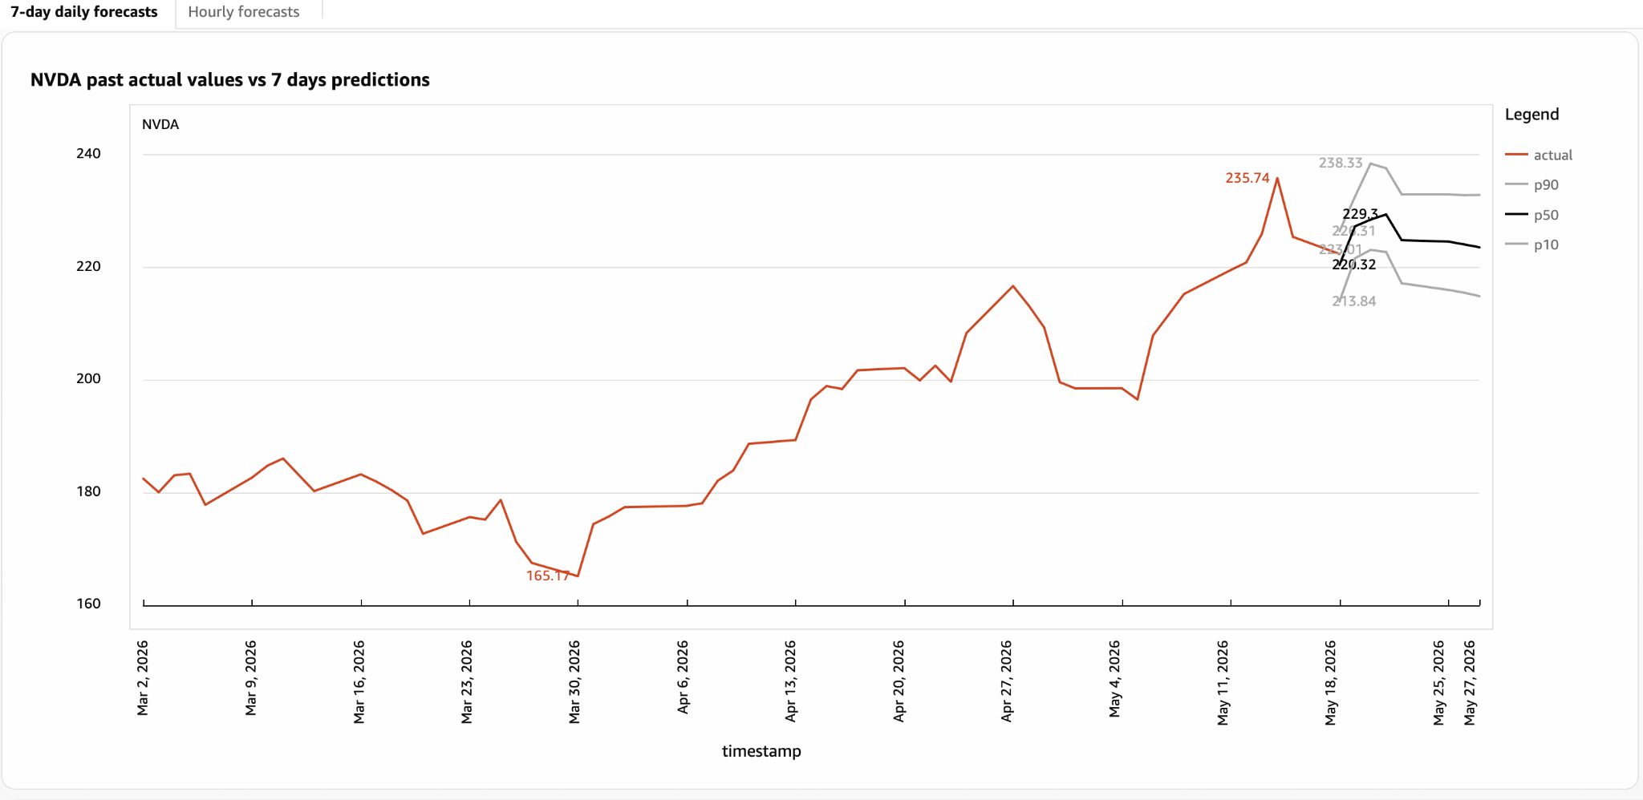
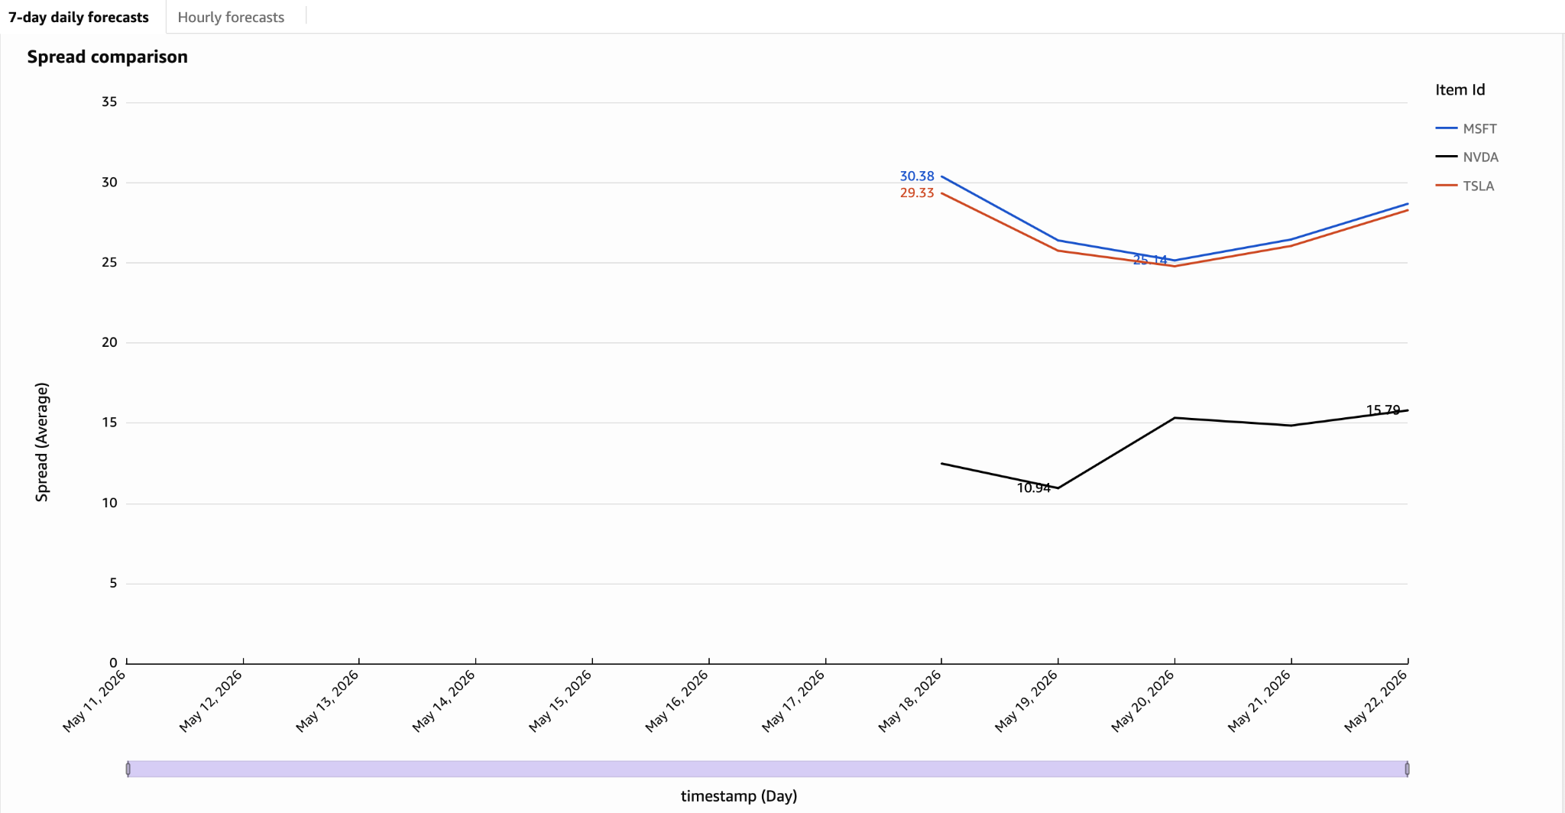
13 · SECOND VISUALIZATION
SPEAKER · FRANCESCO
7-day Daily Forecasts sheet
Longer-range predictions with a forecasting horizon of 7 days ahead, updated once a day.
Spread comparison chart across the three assets.
TEAM 11_02 · NEAR-REAL-TIME FINANCIAL FORECASTING ON AWS · CCBDA-MIRI 2026
13 / 14
Notes:
The results. On the left, the hourly model at one hour ahead is very accurate, MAPE of zero point one nine percent on Tesla, zero point one three on Microsoft, zero point three five on Nvidia. At one hour, with sentiment in the mix, it's essentially tracking the market. On the right is the daily backtest by horizon. Error grows from three percent at day one to about eight percent at day seven, and the P ten to P ninety coverage shrinks from sixty six percent to thirty two percent as we look further out. That widening uncertainty is exactly what we'd expect, and it's why we publish a band, not a single point.

Slide 15
14 · ENGINEERING · LESSONS · CLOSE
SPEAKER · ILIAS
Engineering hygiene and what we learned.
ENGINEERING
LESSONS
GitHub Actions CI on every push · static checks + 50 pytest test .
Cross-account IAM was the hardest part · the streams policy in particular.
Docker health-probe container for the API surface.
Probabilistic validation only works on real data · the P90 story matured late.
Makefile wraps every operator action (make check,make health …)
Twelve-factor · 10 fully met · 1 N/A (Port binding ) · 1 partial (Dev/prod parity )
Pivoted away from AWS Forecast early · DeepAR gave us the control we needed.
TESTS
12-FACTOR
LAMBDAS
50
10 / 12
11
PYTEST
COST · ACADEMIC CREDIT USAGE
TOTAL SPEND
STEADY-STATE
AVOIDED
$0.35
$0.20 / mo
~$43 / mo
OF $100 ACADEMIC CREDIT
GLUE + S3; COMPUTE SCALES TO ZERO
VS ALWAYS-ON REAL-TIME ENDPOINT
Automated, serverless, end to end. Thank you. Questions?
14 / 14
Notes:
To close, engineering and lessons. The repo runs GitHub Actions on every push, static checks plus fifty pytest tests, a Docker health probe, and a Makefile that wraps every operator action. We meet ten of the twelve factors cleanly, one is not applicable to a serverless design, one is partial. Three lessons. Markets close on weekends, which breaks naive time series assumptions, so we handle the gaps. Cross account IAM was the hardest part, the DynamoDB stream policy especially. And validating probabilistic forecasts only really works on real data, which is why the P ninety story matured late. We also dropped AWS Forecast early, it didn't give us the control DeepAR did. On cost, the whole thing ran for thirty five cents of our hundred dollar credit, and zero per month at idle. That's the system, thank you, we're happy to take questions.

